Slide 1




Maze with Mind
Presented by Deep, Johnny, Rahul
BrainHACK Fall 2025

Slide 2

Overview
Background Knowledge
Our Goal
Set Up
Process
Results
Conclusion

Slide 3

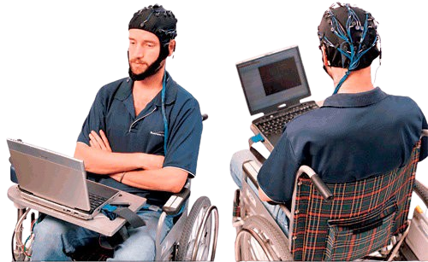
First things First
BCI
(Brain-Computer Interface)
Direct communication between the brain and a computer
Brain generates electrical signals when we think or move

Slide 4
What is SSVEP?
Steady-State Visually Evoked Potentials are brain responses to visual stimuli flashing at a constant frequency.
When the retina is stimulated by a flickering light , the brain generates EEG signals at that same frequency (and its harmonics).
These signals are strongest over the occipital lobe (visual cortex)
https://www.researchgate.net/publication/336549040/figure/fig1/AS:871225031155717@1584727642597/Example-of-Brain-Computer-Interface.jpg

Slide 5
Using SSVEP for BCI
If multiple targets flicker at different frequencies, a user’s brainwaves will naturally “lock onto” (entrain to) the frequency of whichever target they are attending to. By analyzing the EEG for frequency content, we can determine which stimulus the person is looking at.
In other words, the flicker frequency acts as a built-in code for the user’s choice – the brainwave contains a peak at that frequency for the attended target.
https://www.researchgate.net/publication/336549040/figure/fig1/AS:871225031155717@1584727642597/Example-of-Brain-Computer-Interface.jpg

Slide 6

As the name suggests, we will try to solve a maze with telekinesis.
What is Maze with Mind
Only if it was so easy to master it but worry not becasue we have BCI.
01
02
03
04
Game Premise: Maze with Mind is a simple maze navigation game where the player’s avatar is controlled by brain signals rather than a keyboard or controller.
Flickering Directional Cues: We placed four visual stimuli corresponding to the four directions (up, down, left, right) on the screen.
Control Mechanism: The player simply looks at the cue for the direction they wish to move.
Visual Feedback: The maze and avatar are displayed on the same screen, behind or alongside the flickering cues. When the system detects a direction, the avatar moves one step in that direction

Slide 7
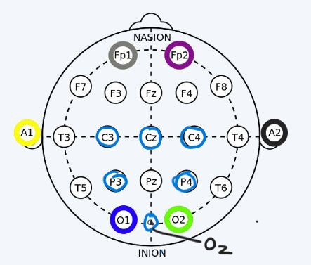
Set Up
01
Signal Acquisition — 8-channel EEG focused over occipital sites (O1, Oz, O2, etc.), ~250 Hz sampling, low-impedance contacts (dry OK) to capture SSVEP reliably.
02
Preprocessing — Band-pass 5–50 Hz + 60 Hz notch; suppress blinks/EMG; analyze sliding ~1.0 s windows (with harmonics) for responsive yet stable frequency evidence.
03
Frequency Decoding (CCA) — Correlate multi-channel EEG with sine/cos reference pairs at each target frequency (f, 2f); pick max correlation ⇒ intended direction. Zero-training, robust in noise.

Slide 8
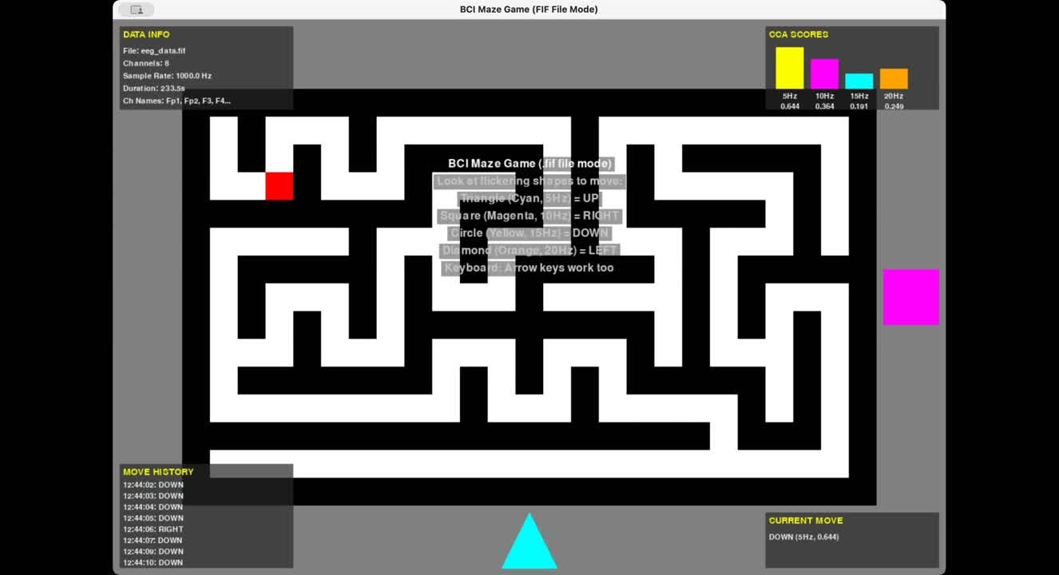

Slide 9
Key Innovations
01
02
03
04
Hands-free control: Pure EEG → game; no controller/eye-tracker—demonstrates true no-contact interaction and accessibility.
Real-time CCA decoding: Multi-channel CCA with harmonics for robust, zero-training SSVEP classification—even on 8 channels.
Intuitive gaze UI: “Look = move” mapping (four flicker targets) lowers learning curve; users feel seamless, natural control.
Accessible build: Low-cost headset, dry electrodes, laptop + standard display; open-source stack (EEG → CCA → game).

Slide 10
Challenges, Solutions & Outcomes
01
02
03
04
Noisy EEG (blinks/EMG): Band-pass + notch + windowing; coach relaxation → stable SSVEP peaks.
Few electrodes (8ch): Occipital montage (O1/Oz/O2/POz) + CCA spatial leverage → reliable detection.
Visual fatigue: Comfortable frequencies (~7.5–12 Hz), small peripheral cues, short runs → good tolerance.
Flicker timing: 60 Hz-aligned frequencies + frame-locked updates → precise stimuli, better accuracy.

Slide 11

The End
Special Thanks to Max, Can, and Jordan for the help and support, and for hosting this

